Slide 1

FED
WE
E
K
Embedded HTML Elements
HTML Form Elements & Web Forms
Front End Development
Diploma in CSF
Year 1 (2021/22), Semester 2
2

Slide 2
Remote Learning Instructions
Step 1
Read the given slides
Details in slide 1-9
Attempt the Exercise
Details in slide 7
Step 2
Perform highlighted activities in Activities slide
Details in slide 10
Step 3
Complete and Submit Tasks given
Details in slide 11

Slide 3
HTML Form
Embedded HTML Elements
How to embed external content into an HTML document
The primary types of embedded content are images, audio, and video
HTML Form Elements Web Forms
HTML elements that support user input
How forms are submitted
Input elements that are used to collect user input
Data input validation

Slide 4
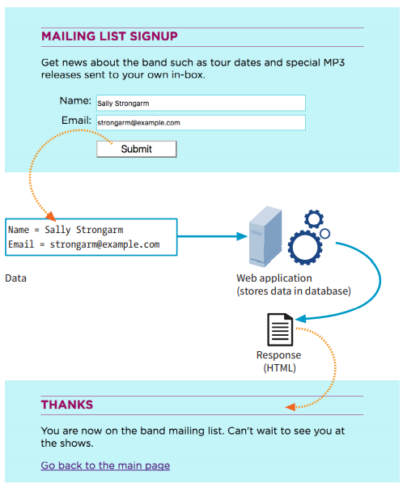
HTML Form (Cont)
However, for FED, we will focus only the frontend interface and not the backend processing.

Slide 5
Topics 1/2
Embedded HTML Elements
Anchor
Images
Audio
Video
HTML Form Elements
Form Element
Input Elements
Other Visual Elements
Button Types
Organising a Form
Validation

Slide 6
Topics 2/2
HTML Web Forms
Autofilling previously entered data with autocomplete
Constraining form field data with a regular expression
Using text-selection APIs
Building CSS styling for invalid, valid, and required fields
Creating a search field
Including a phone number input field
Formatting number fields
Building a date picker
Creating a list of suggested entries
Indicating measurements

Slide 7
Exercise
Attempt “FED 2021-10 Week 2 Exercise.docx”
NB: Files can be downloaded from MEL
Tasks | Videos
Create Hyperlinks
Responsive Images
Images Dependent on Browser Dimension
Embed Audio and Video

Slide 8
HTML Form
Video on HTML Form (reference for worksheet)
Tasks | Videos
HTML Form 1 | https://www.mikedane.com/web-development/html/inputs-forms/
HTML Form 2 | https://www.youtube.com/watch?v=2JrGepWlUvg
HTML Select Option | https://www.youtube.com/watch?v=3NXVoEmgRMk
HTML Fieldset and Legend | https://www.youtube.com/watch?v=S7M5GMZ2CTk
https://www.youtube.com/watch?v=vj78j_Sy3uM
NB: Files can be downloaded from MEL

Slide 9

Reference
Learning Web Design
A Beginner’s Guide to HTML, CSS, JavaScript and Web Graphics
Jennifer Niederst Robbins
Available to download from NP library:
https://ebookcentral.proquest.com/lib/np/detail.action?docID=5412749&query=Learning+Web+Design
Companion website for the book:
learningwebdesign.com

Slide 10
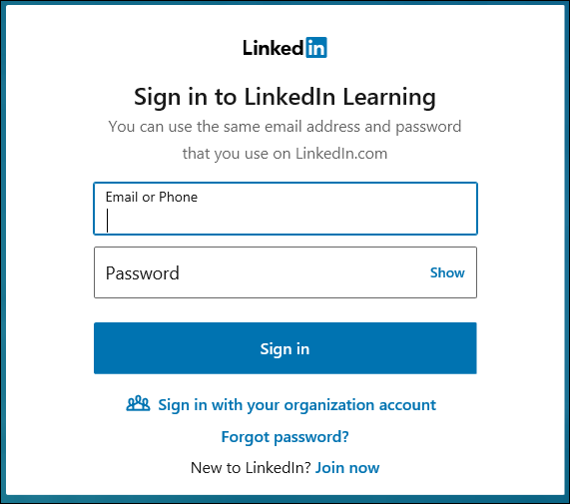
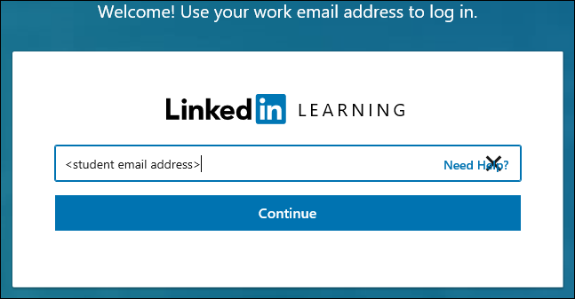
Activities
Read Part II – HTML For Structure (Chapters 7, 9, 10) from the textbook.
(Optional) Watch the video clips under topic HTML5: Web Forms (1h 58m)
https://www.linkedin.com/learning/html5-web-forms/welcome?u=42538748
Sign in with your organization account (student email address)

Slide 11
Tasks
Complete Week 2 Practical.
Download Week 2 Practical in MEL – “FED 2021-10 Week 2 Worksheet.pdf”
Deadline end of Week 2
Submit the completed practical files in MEL.
Zipped the source files
Name the zipped file in following format:-
FED-Week02-SXXXXXXXX (where SXXXXXXXX is your student id)
Submit the zipped file in the weekly folder’s submission link in MEL
Also, submit the zipped file into FED network folder (https:///ictspace.ict.np.edu.sg/FED) under your studentID. This is for backup purpose only. Main submission is still in MEL.
If you have any questions please communicate with your tutor via Microsoft Teams.

Slide 12
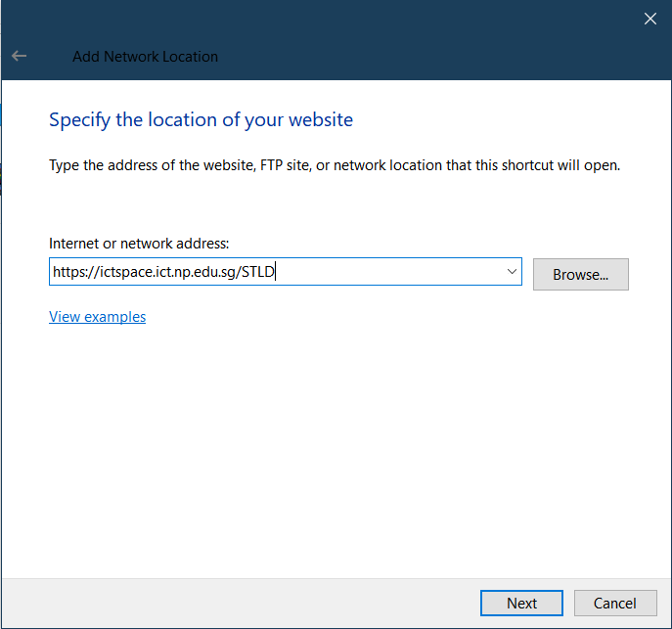
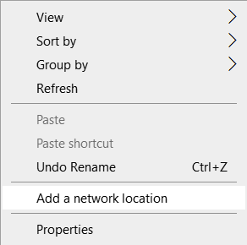
Appendix
Mapped to FED network folder
For Win Users
Right click on a blank space in your Windows Explorer
Select ‘Add a network location’
3. Enter https://ictspace.ict.np.edu.sg/(your assigned module)
4. Press ‘Next’

Slide 13
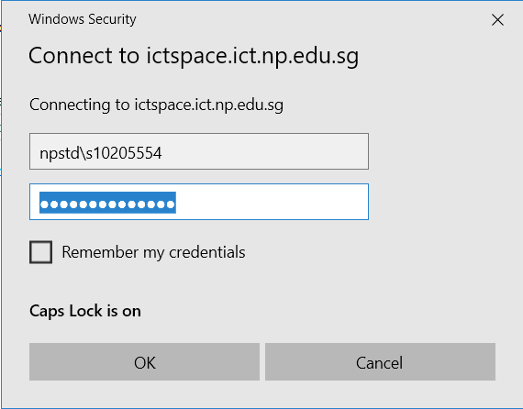
Appendix (Cont)
10123453
4. Login using npstd\s(your student ID number without the last alphabet)
5. Enter your NP student account password

Slide 14
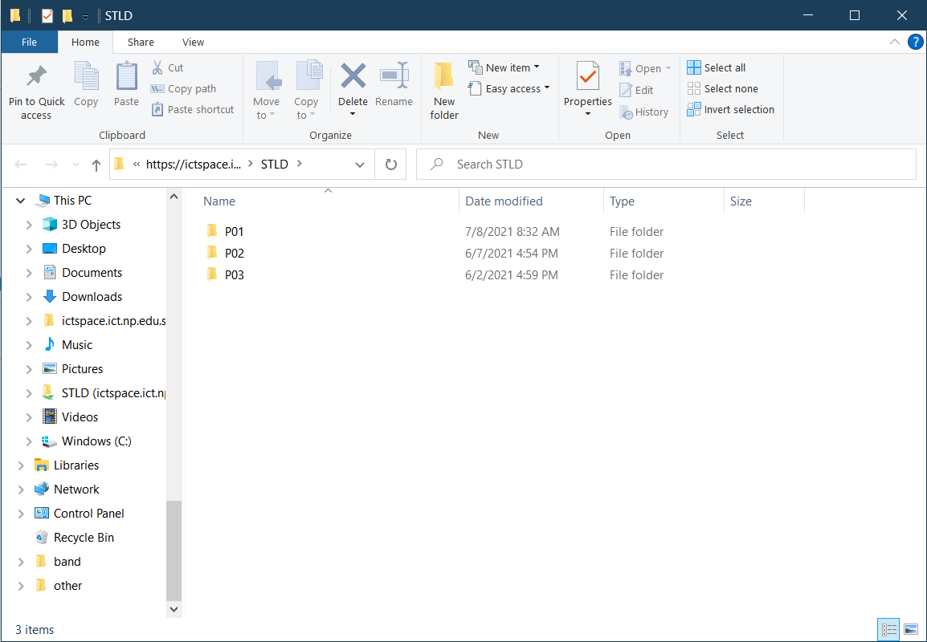
Appendix (Cont)
You should be able to see your class folder as shown in the example below.

